Slide 1
Learning to Think Like a Hacker
Ben Holland
bholland@iastate.edu
ben-holland.com/slides

Slide 2
Who Am I?
Ben Holland
B.S. in Computer Engineering (2005-2010)
B.S. in Computer Science (2011)
M.S. in Computer Engineering and Information Assurance (2012)
ISU Research Associate (present)
DARPA grant for Android malware detection research
I just never left. So super duper Senior?

Slide 3

Let’s break the ice…

Slide 4
What’s a Hacker?

Slide 5
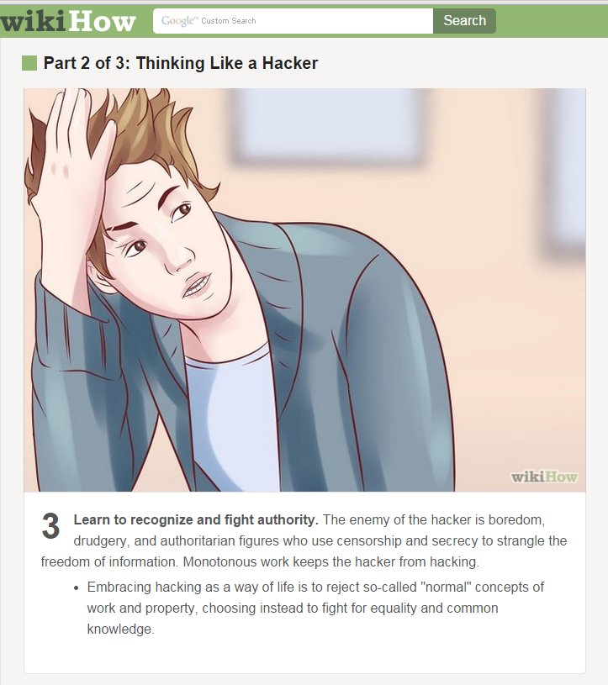
A little melodramatic…
Who draws all these anyway?

Slide 6
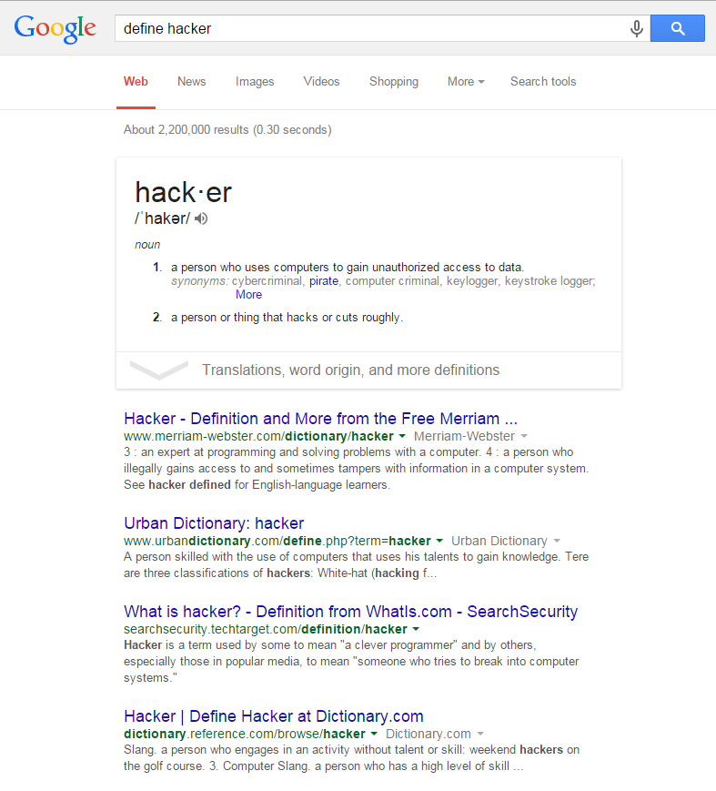
Ok the media definition of hacker wins…
Hackers are criminals by popular definition.

Slide 7
Let’s define hacking (in non-media terms)
Problem solving
Critical thinking
Tinkering
Exploring how things work

Slide 8
Outline
Hacking Physical Systems (15 mins)
Activity 1 (10 mins)
Hacking Digital Systems (10 mins)
Activity 2 (5 mins)
Hacking Social Systems (5 mins)
Activity 3 (5 mins)
Related ISU Programs (5 mins)
Q/A (5 mins)

Slide 9
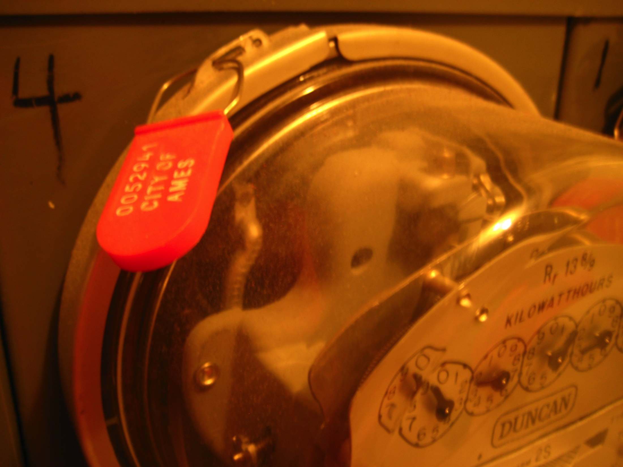
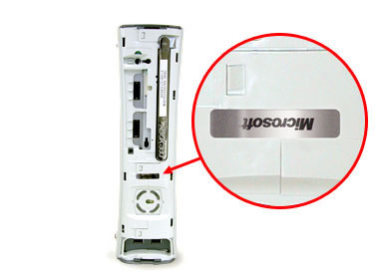
Hacking: Tamper Evident Devices
Detect unauthorized access
Not a “lock”
Also known as “seals”
How is the seal inspected?

Slide 10
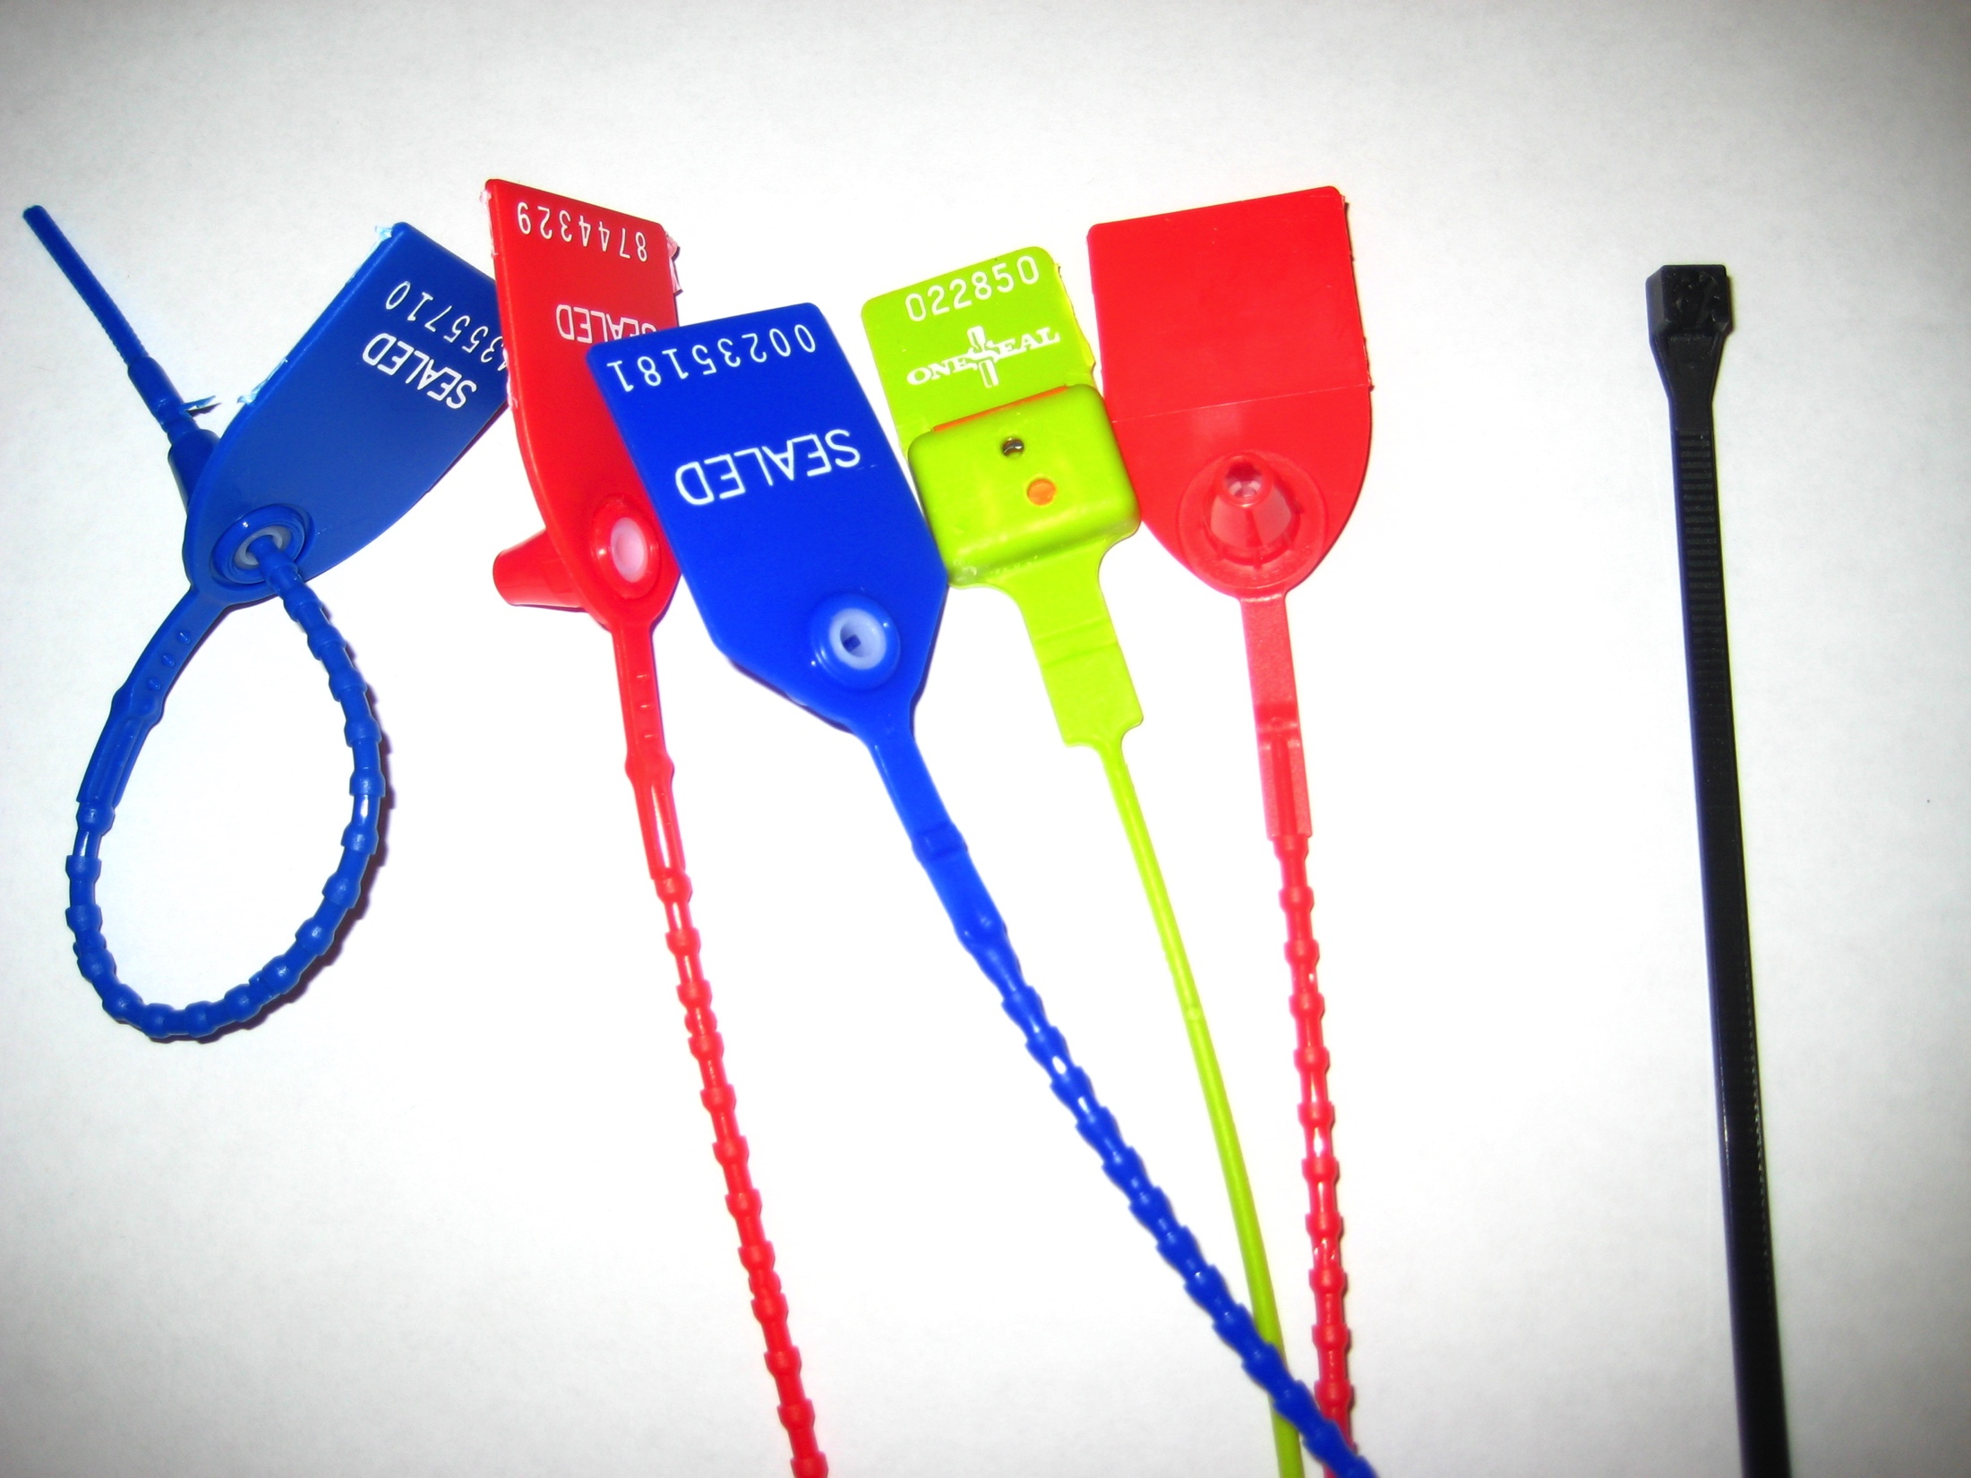

Slide 11
Defeating Tamper Evident Seals
Important Question: How does it work?
Works similar to a zip tie

Slide 12
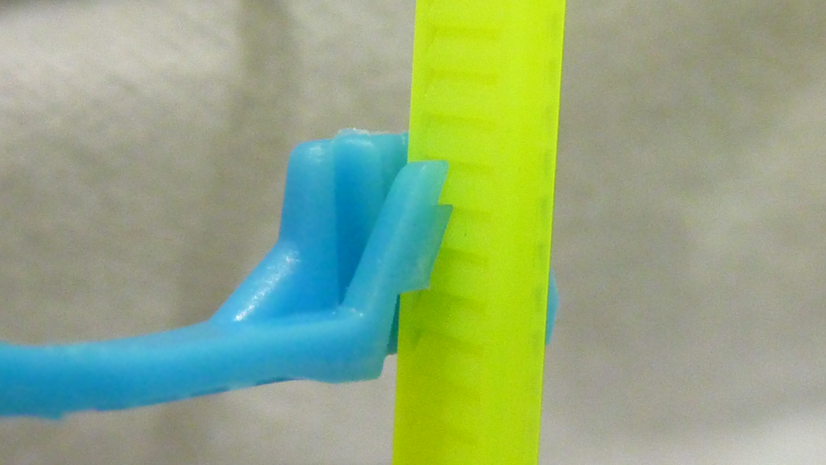
Cutaway of a Zip Tie

Slide 13
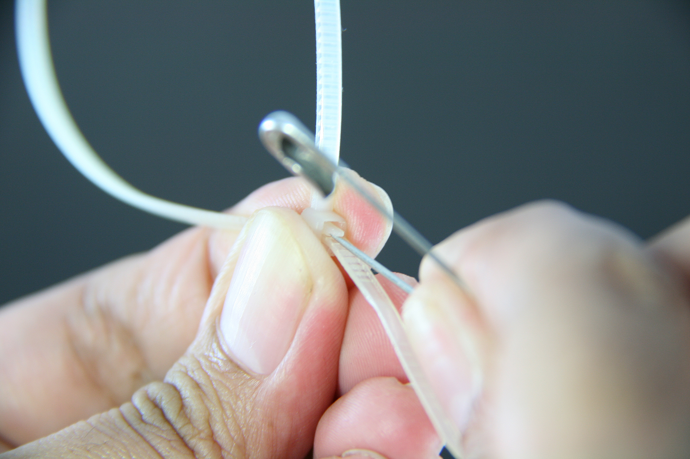
Defeating a Zip Tie

Slide 14

How do we defeat this seal?

Slide 15
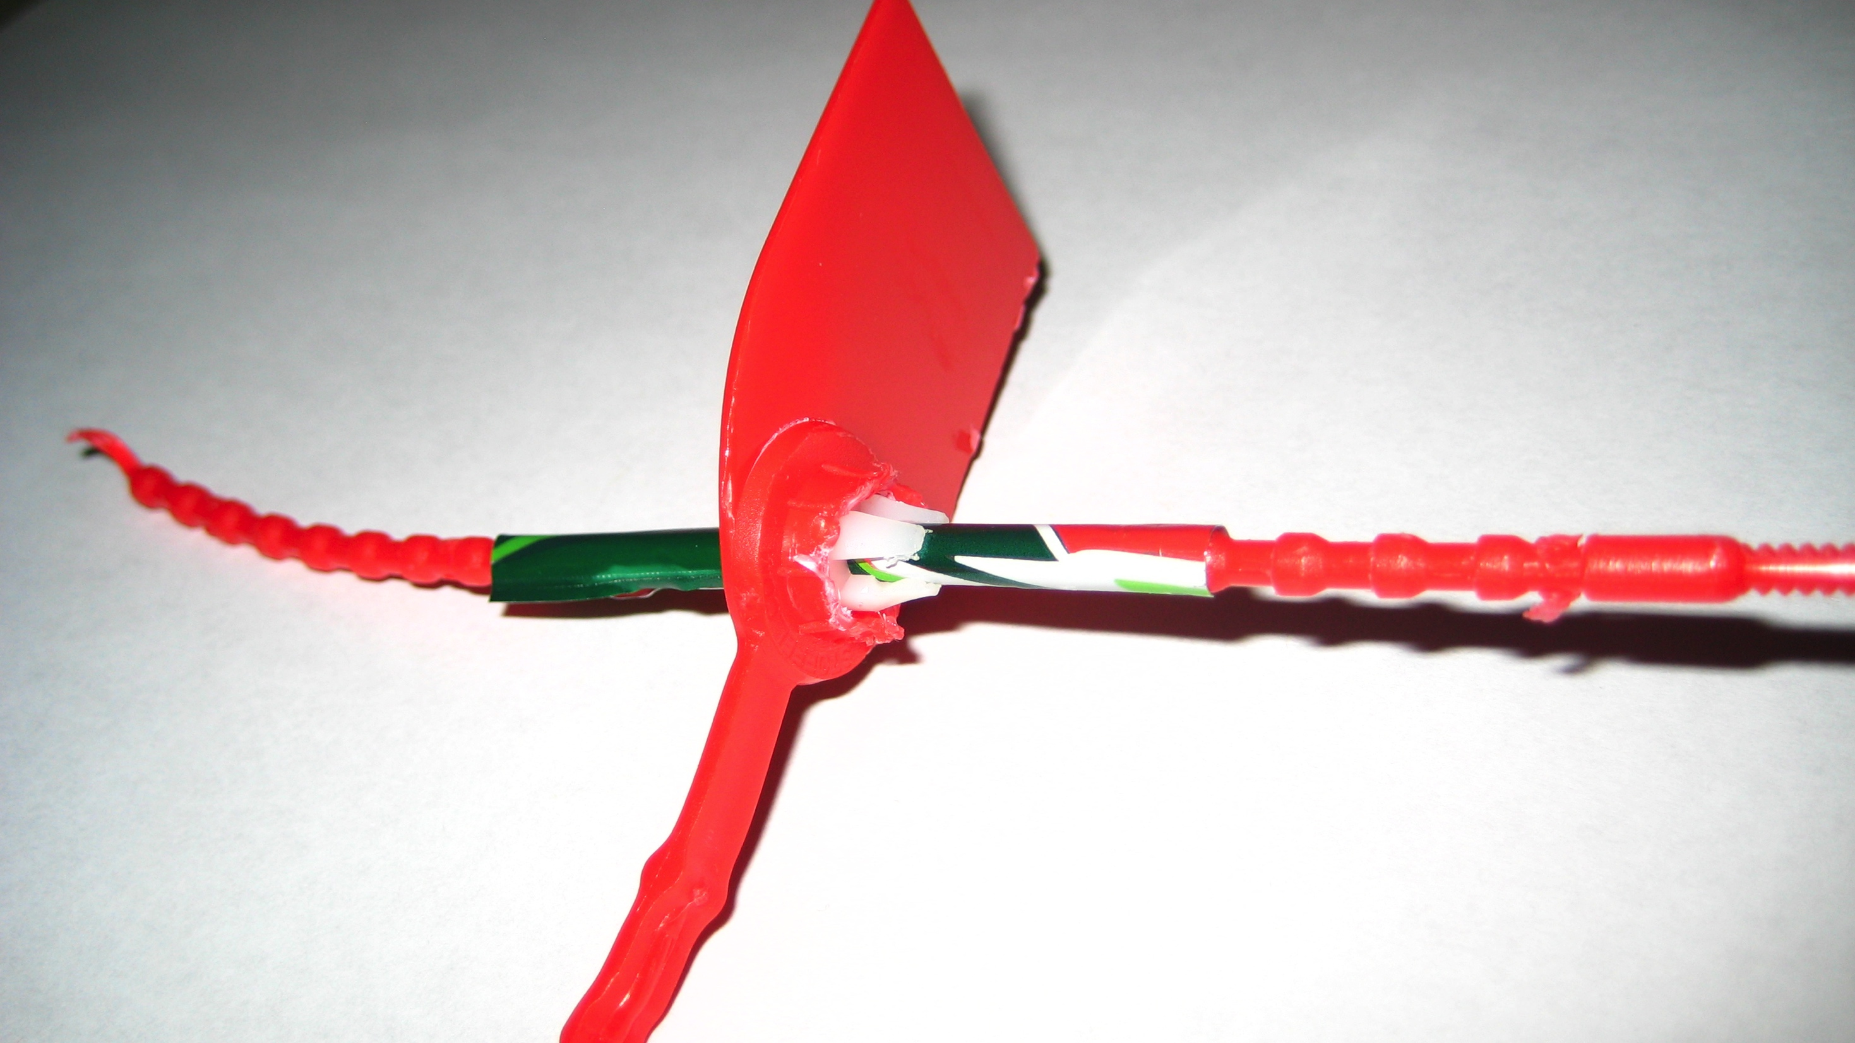
Shimming with a pop can…

Slide 16
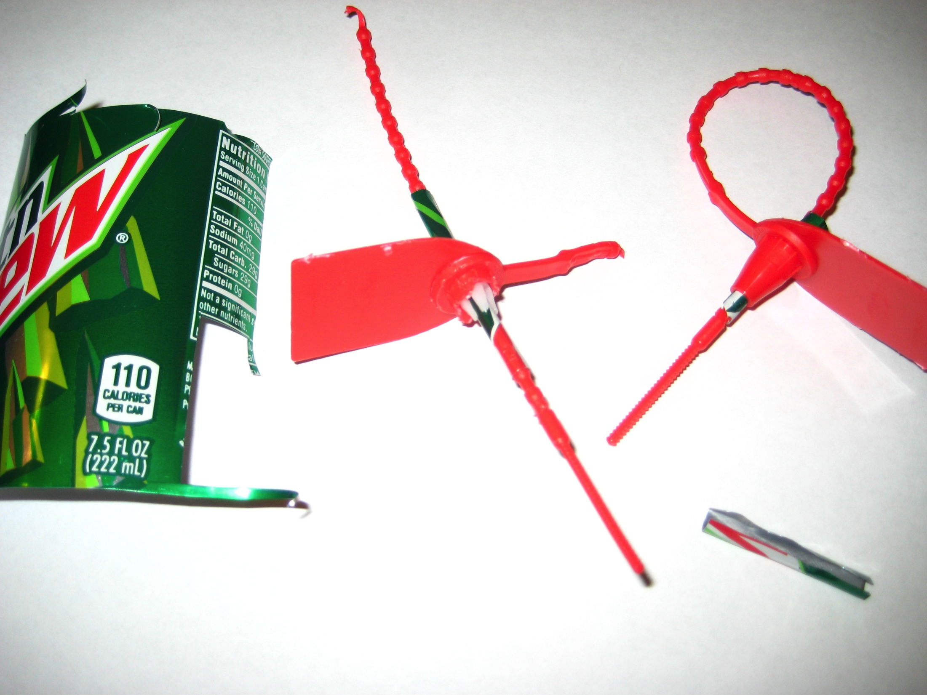

Slide 17
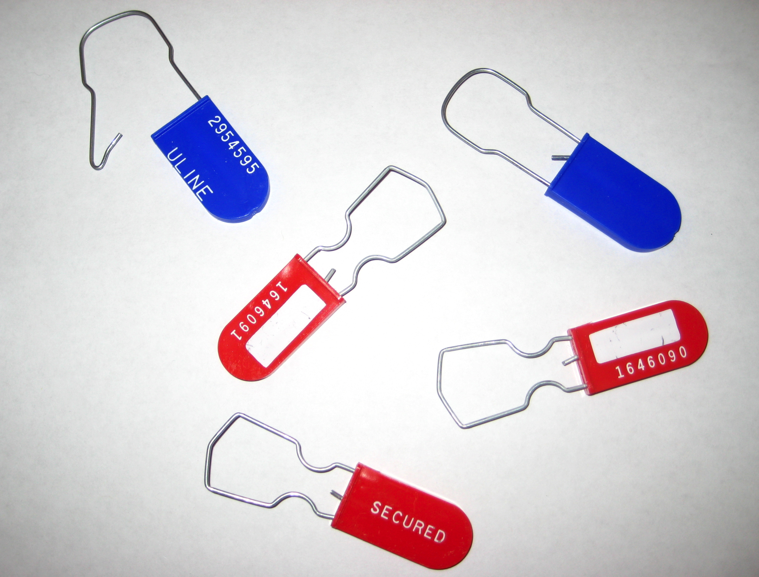
How do we defeat this seal?

Slide 18

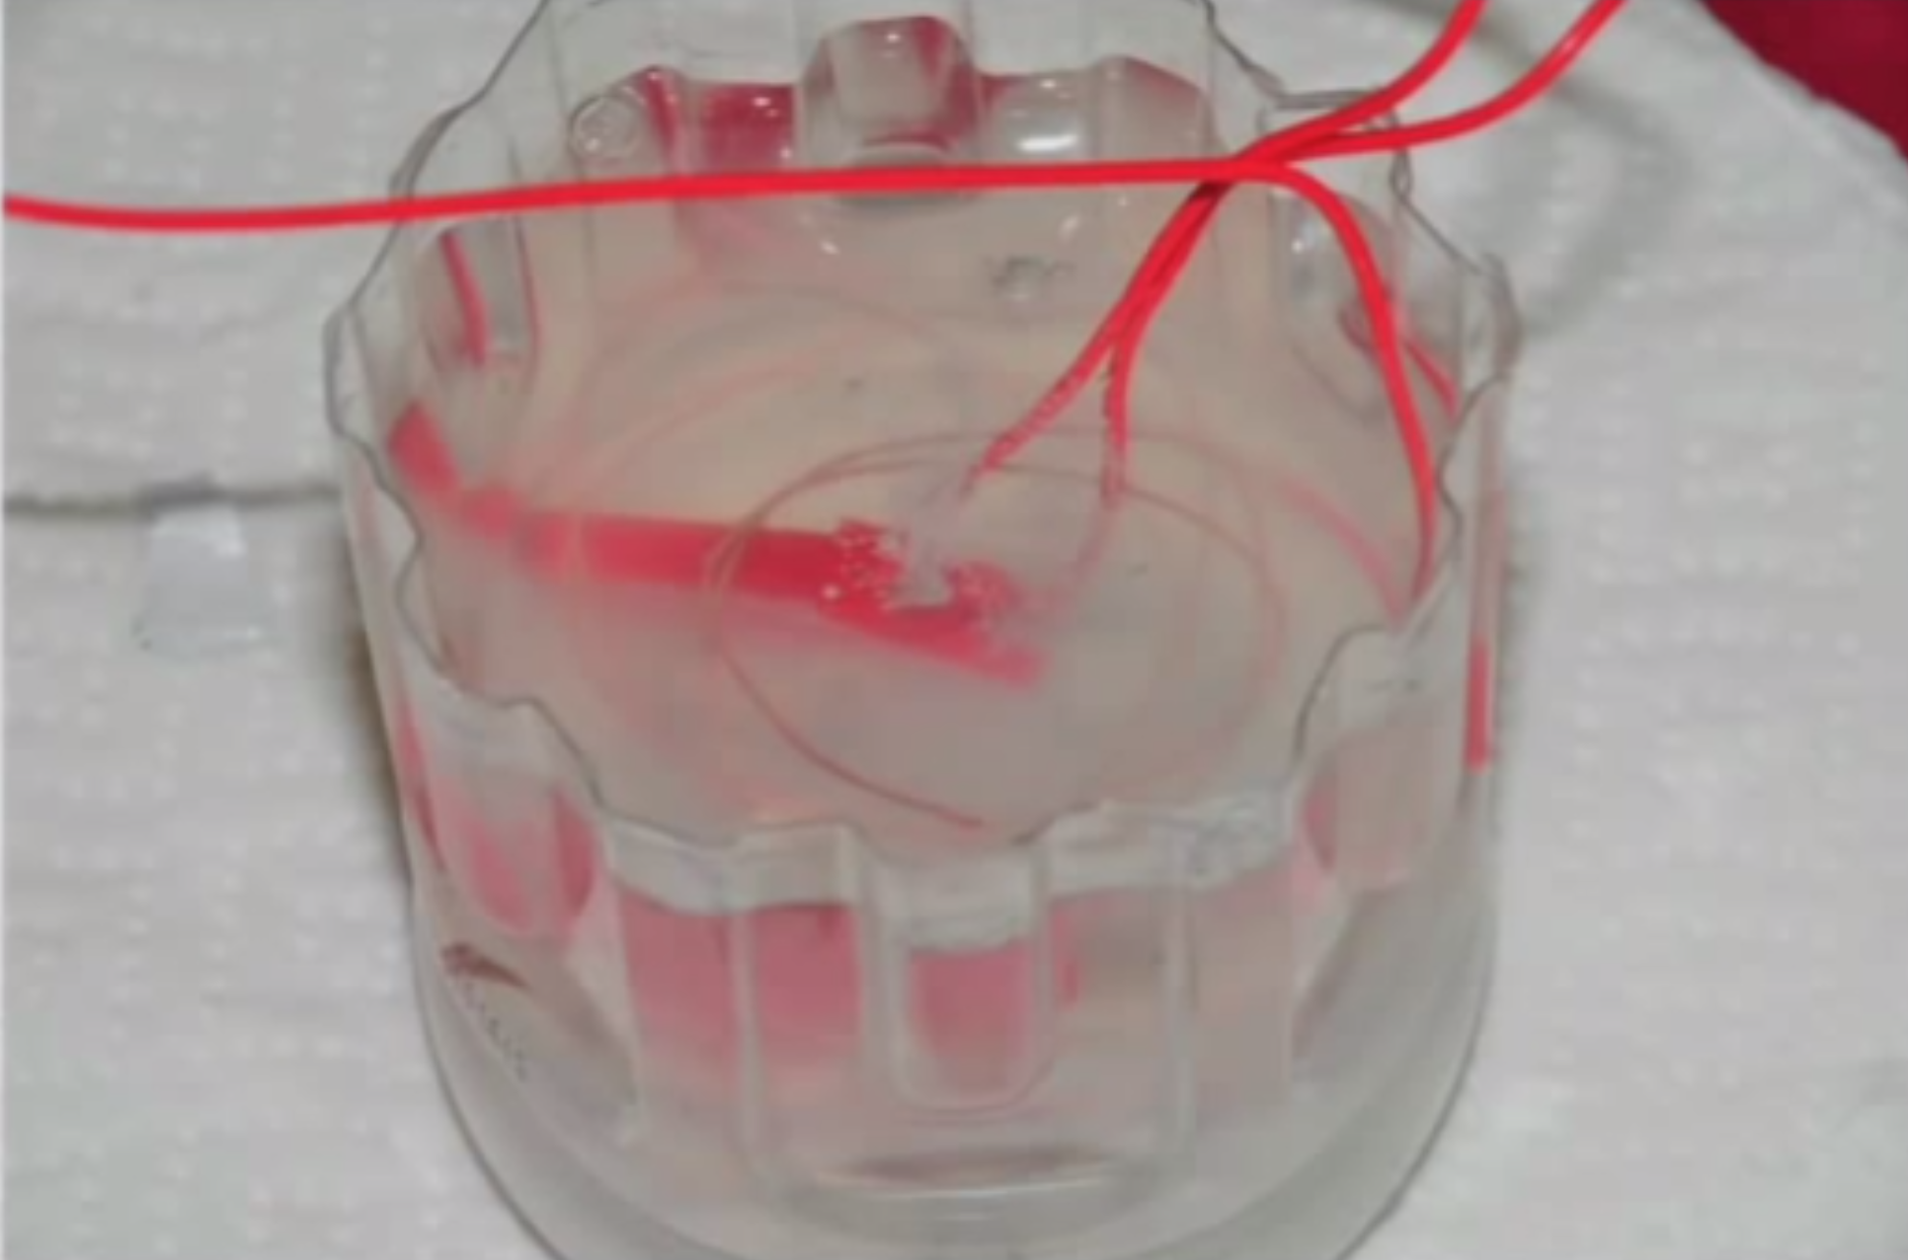
Defeating Tamper Evident Seals
How does it work?

Slide 19
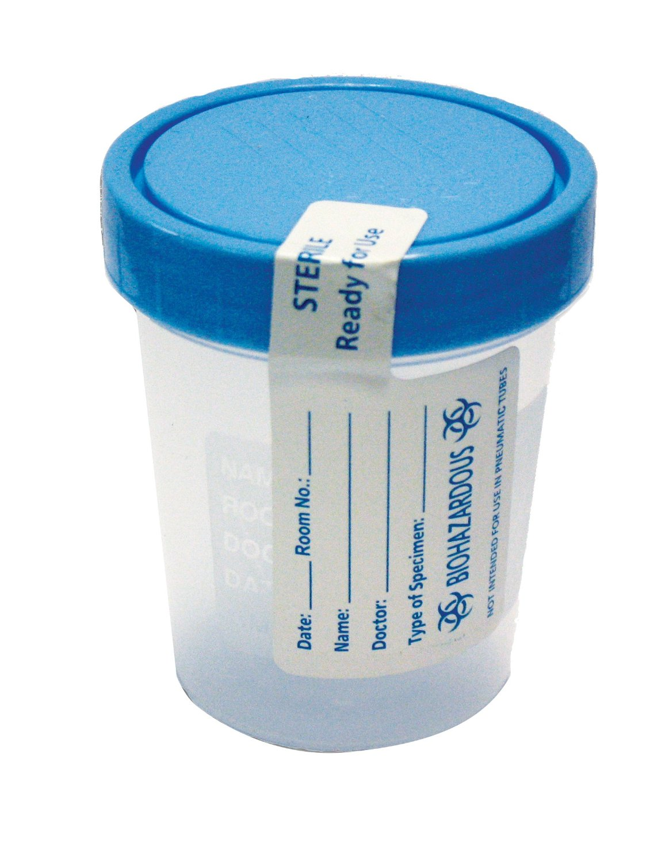
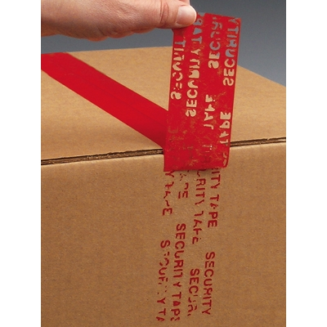
Tamper Evident Adhesives

Slide 20
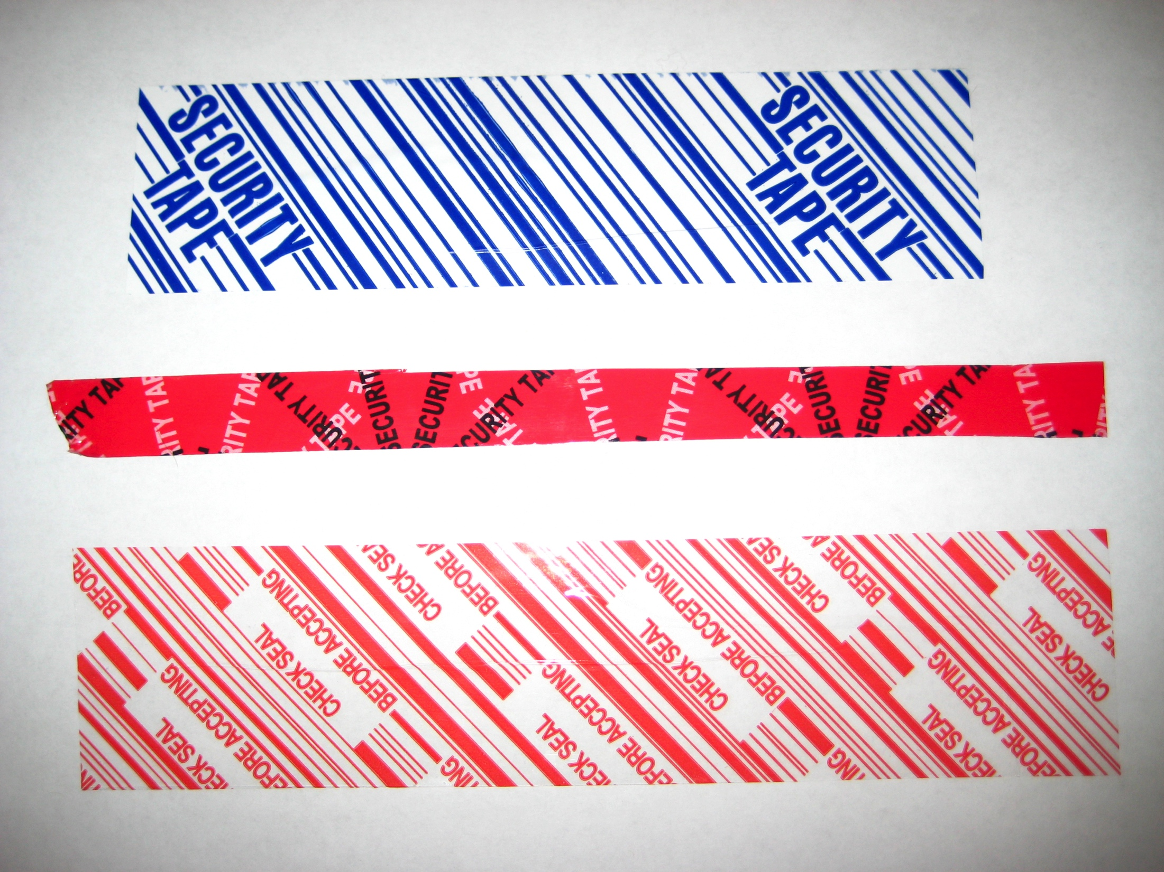

Slide 21
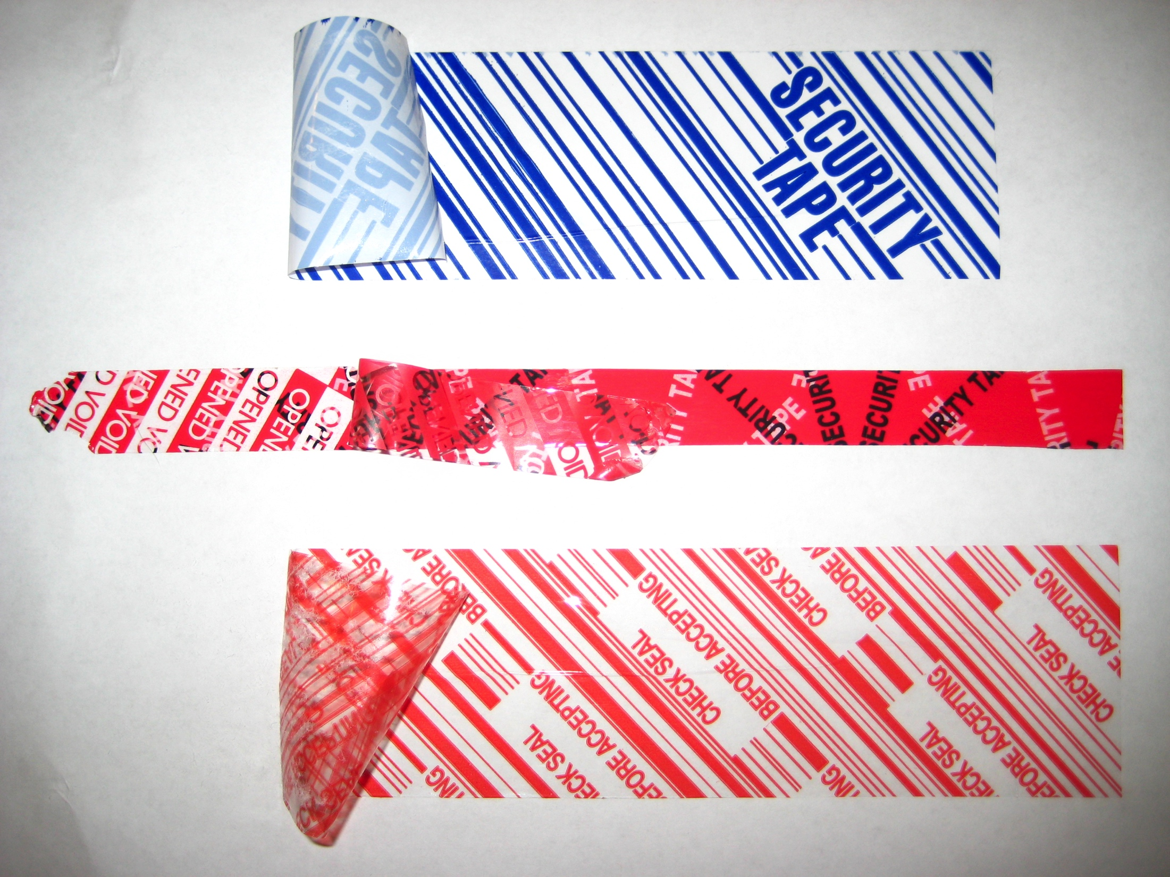

Slide 22
Defeating Adhesive Seals
Dry Peeling/Breaking/Lifting
Water/Steaming
Heating/Cooling
Counterfeiting (replace)
Solvents
Acetone (nail polish remover)
Isopropyl Alcohol
Mineral Spirits
“Stamp lift” Fluid

Slide 23

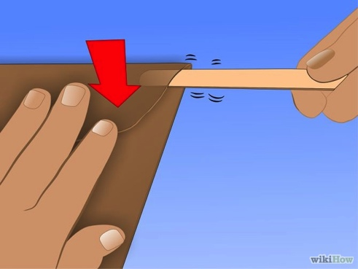
Mail Tampering

Slide 24

Breakout Session 1
Get into groups (5-8 people)
Try shimming/defeating the seal
Try a dry break for envelope tampering
Be creative, experiment, share what you learn with your team!
10 minutes!

Slide 25
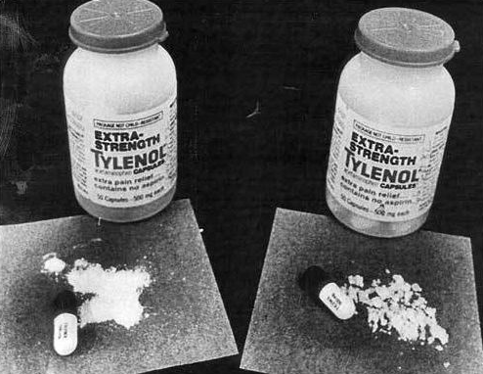
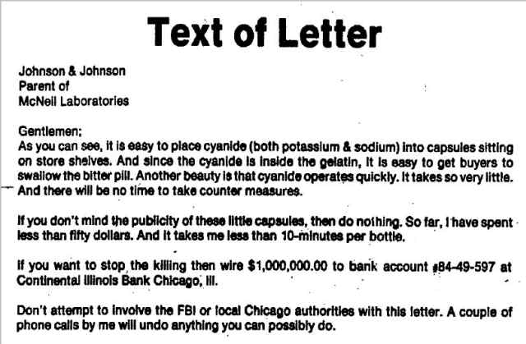
Tamper Evident Devices
Cyanide-laced Tylenol Murders 1982-1986
Never solved, several copycat killers
Some bottles had broken seals
Federal Anti-Tampering Act 1983

Slide 26
Hacking: Physical Systems
Checkout DEFCON 19: Introduction to Tamper Evident Devices talk
https://www.youtube.com/watch?v=SIQml3MBJoE
Des Moines Lock Pick Club
http://www.dsmlocksport.com

Slide 27
Hacking: Voicemail
What question(s) should we ask?

Slide 28


How does voicemail work?
(222) 333-4444
(515) 867-5309
I am (222) 333-4444 calling (515) 867-5309
Hello!

Slide 29

How does voicemail work?
(222) 333-4444
(515) 867-5309
I am (222) 333-4444 calling (515) 867-5309
Leave a message…

Slide 30
How does voicemail work?
(515) 867-5309
I am (515) 867-5309 calling (515) 867-5309
You have a message!

Slide 31
How does voicemail work?
(222) 333-4444
I am (515) 867-5309 calling (515) 867-5309
You have a message!

Slide 32
Breakout Session 2
Fake Victim: (515) 200-1301
Please nominate one person per group to make spoofed calls!
SpoofCard Service: (305) 501-2777
Press 1 (login with your phone number)
SpoofCard User: (319) 435-0116
SpoofCard PIN: 1234
Press 1 (place a call)
Press 1 (use your normal voice)
Press 2 (don’t record call)
Caller ID spoofing is legal in the United States if it is not done with “the intent to defraud, cause harm, or wrongfully obtain anything of value”.

Slide 33
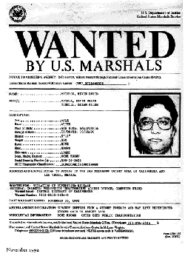
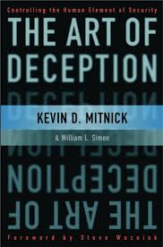

Hacking: Social Systems
Social Engineering
Kevin Mitnick
Caught 1999 -> prison
Made an example of
No phone calls
Solitary confinement
Now does consulting

Slide 34
Breakout Session 3
Scenario: You work as a programmer for Facebook. Facebook pays the public for first reports of major security bugs reported (bug bounties). Facebook gets a report that a bug in Facebook allows anyone to view private Facebook accounts under rare conditions.
Debate the following with your group:
You intentionally wrote this “bug” and sold it to your friend at Microsoft. Your friend claimed the reward money and split it with you. Is this unethical? Is this illegal?
You quit Facebook. After a few months you are thinking about code you wrote and realize the bug exists. Your employee contract said employees can not claim bug bounties. So just to be safe you register a fake Facebook account to report bug under and claim the reward money. Is this unethical? Is this illegal? What if you sold to the Government? Which Government?

Slide 35
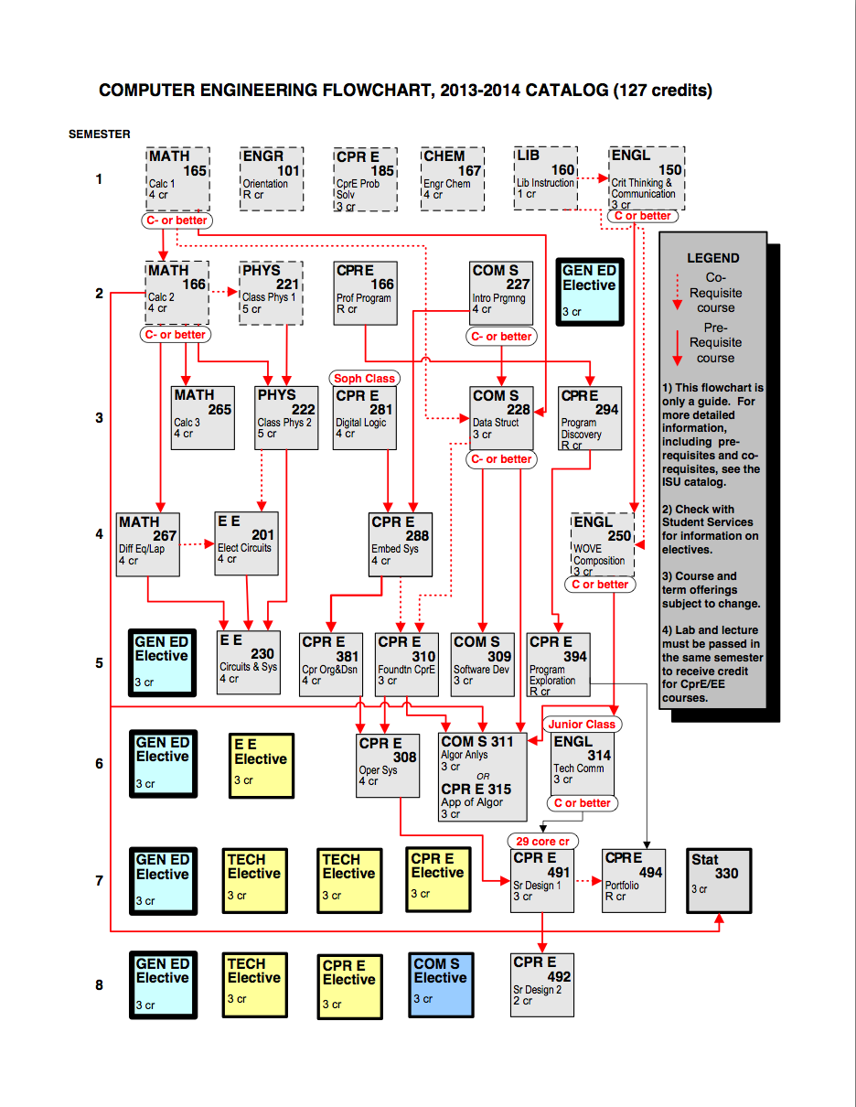
Degree Curriculums
Google “iastate <your major here> flowchart”
Computer Engineering (CprE)
Electrical Engineering (EE)
Software Engineering (SE)
Computer Science (CS)
Management Information Systems (MIS)
Graduate Program
Information Assurance (INFAS)

Slide 36

Cybersecurity @ ISU
Political Science
MIS
Masters in Information Assurance (INFAS)
Cryptology/Steganography
Reverse Engineering
SCADA Systems
Digital Forensics
Network/Wireless Security
Laws and Ethics
Information Warfare, Capstone
NSA designated Center of Excellence in INFAS Education
Any 4 classes earns you two Gov. certifications
Information Assurance Security Group (IASG)
Club open to everyone!
Cyber Defense Competitions
Class credit, hands on experience, professional Red team
Business
Math
SE
EE
CS
CprE
INFAS

Slide 37
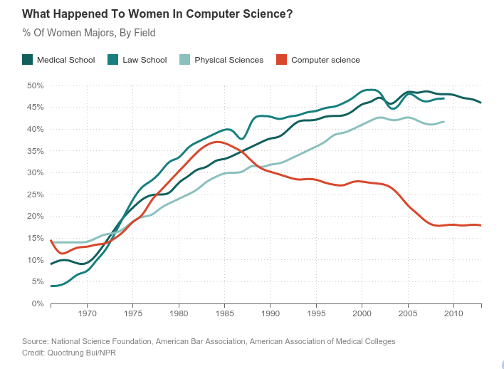
Let’s fix this!

Slide 38
What do you want to talk about?
Slides here (if you want them): www.ben-holland.com/slides
Thanks for coming out today!
Questions?

Slide 39
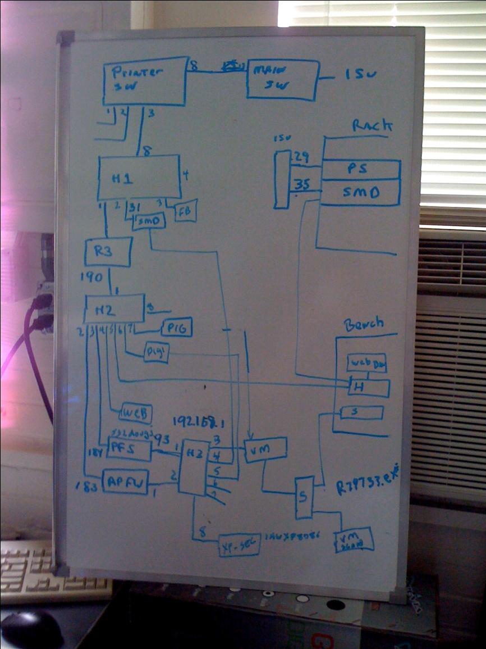
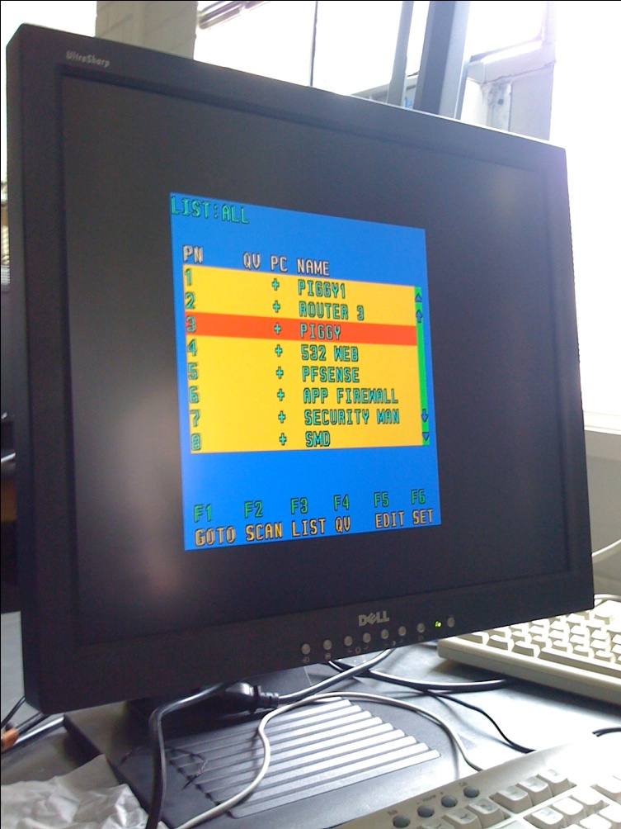
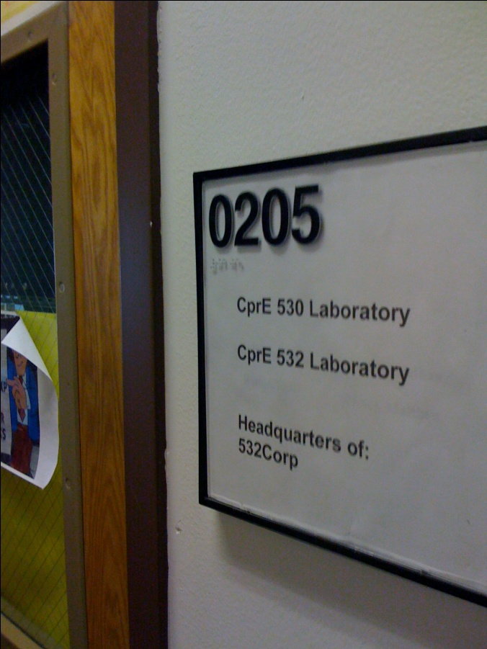
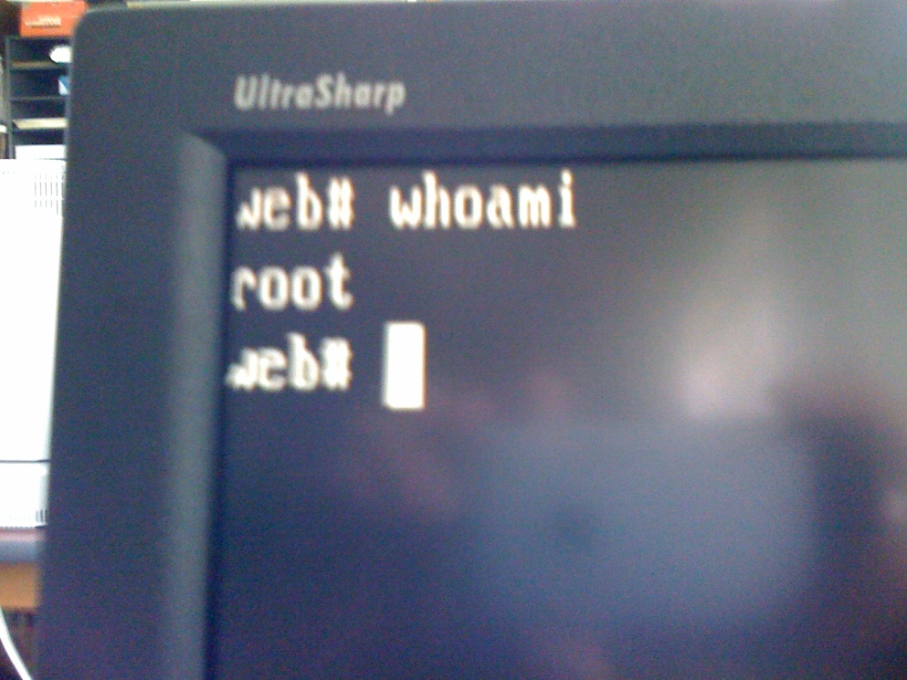
Information Warfare (CprE 532)
Physical Break-in Story

